Slide 1

A review of good practice and remediable factors in the delivery of care provided to adults with a learning disability when admitted to hospital acutely unwell.
Key messages and recommendations

Slide 2

Method
Study population:
Patients aged 18 with a diagnosed learning disability who attended/were admitted to hospital as an emergency between 1st July and 30th September 2024.
Data sources:
666 clinician questionnaires
366 sets of case notes reviewed
144 primary care questionnaires
199 organisational questionnaires
832 healthcare professional survey responses
82 patient/carer survey responses

Slide 3
Data Returns
12,883 patients with a learning disability, admitted to hospital as an emergency admission for over two days during the three-month study period
*Patients were identified with an ICD10 code for learning disability (F70-F79) or were on a local learning disability register
*Only one admission per patient was included
130 patients were excluded as they did not meet the study criteria
1,040 patients included
666 clinician questionnaires
366 sets of case notes
144 primary care questionnaires

Slide 4
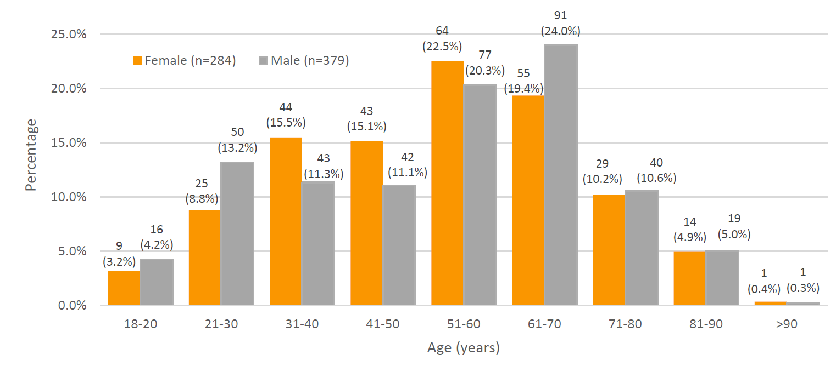
Age and Sex of Study Population

Slide 5
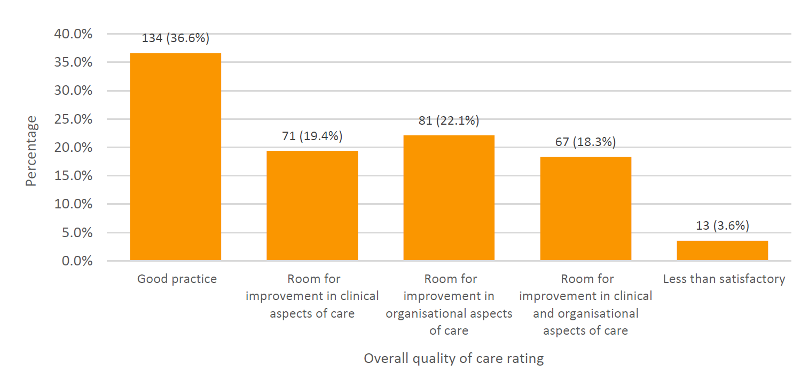
Overall Quality of Care
Notes:
Reviewers rated the overall quality of acute care as good for 134/366 (36.6%) patients. They found room for improvement in 219/366 (59.8%) cases reviewed, and less than satisfactory care in 13/366 (3.6%) cases.
Clinicians completing questionnaires highlighted where improvements could have been made for patients with a learning disability admitted to hospital. These included identification of care needs at the point of admission, earlier and more consistent access to an acute hospital learning disability service, more robust approaches to the assessment of mental capacity, and greater involvement of family and carers to support the assessment and care provided to patients.

Slide 6

KEY MESSAGES

Slide 7
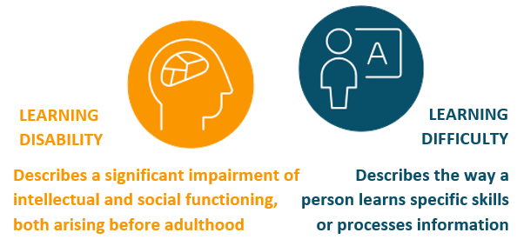
Use the correct terminology. LEARNING DISABILITY and LEARNING DIFFICULTY are not the same and using ‘LD’ does not help.
119/366 (32.5%) patients were described as having a learning difficulty rather than a learning disability and the two terms were often used interchangeably.

Slide 8
1
Accurately record a person’s identified learning disability in the electronic patient record/clinical notes and in learning disability registers/lists.
Diagnosis of a learning disability was not always recorded on a register/list or patient record systems/in clinical notes. In addition, patients were commonly recorded as having a learning difficulty or the terms used interchangeably.
175/196 (89.7%) organisations reported using alerts or flags on electronic patient records.
However, only 310/583 (53.2%) patients had such alerts.

Slide 9

2
Assess and implement reasonable adjustments for patients with a learning disability.
This study found that patients and their carers were often not asked about the reasonable adjustments they needed during their hospital admission. There is a legal duty to deliver reasonable adjustments for patients.
Only 292/666 (43.8%) patients and/or their carer were asked if any reasonable adjustments were needed during the admission.

Slide 10
3
Use decision support tools to aid healthcare professionals when assessing mental capacity in patients with a learning disability.
A person with a learning disability should not be presumed to lack mental capacity to make health related decisions. There was inconsistency in how mental capacity assessments and best interest decisions were made for the patients in this study.
121/229 (52.8%) patients who did not have a formal assessment should have received one.
Only 169/277 (61.0%) healthcare professionals reported being confident in undertaking mental capacity assessments in patients with a learning disability.

Slide 11
4
Consistently and continuously involve people with a learning disability in their care during a hospital admission. This should be from the point of arrival through to discharge.
The report found that people with a learning disability were inconsistently involved in decisions regarding their care. Similarly, carers were not always involved as appropriate.
200/366 (54.6%) patients were involved in decisions regarding their care in the acute setting and in 148/353 (41.9%) cases there was no involvement of the patient or the patient’s carer at discharge.

Slide 12
5
Commission local learning disability support services to enable equitable access to care for patients with a learning disability who attend or who are admitted to hospital.
This study highlighted that acute hospital learning disability services did not always exist and when then did, it was often just one person. This did not allow for a 24/7 service needed to care for patients admitted as an emergency.
Only 35/186 (18.8%) learning disability services were multidisciplinary, 69/186 (37.1%) were a single profession and 82/186 (44.1%) a single individual

Slide 13
RECOMMENDATIONS
All healthcare providers in all healthcare settings should take note of these recommendations.

Slide 14
Accurately record learning disability diagnoses
Accurately record a person’s identified learning disability in the electronic patient record/clinical notes and in learning disability registers/lists.
This information should be accessible across healthcare settings to ensure prompt recognition and proactive care for patients with a learning disability on arrival at hospital.
For action by: Integrated care boards and local commissioners in discussion with primary/community care, hospital trusts/health boards and associated learning disability services as well as electronic patient record providers.
Notes:
RATIONALE FOR THE RECOMMENDATION: Diagnosis of a learning disability was not always recorded on a register/list or patient record systems/in clinical notes. In addition, patients were commonly recorded as having a learning difficulty or the terms used interchangeably.
The current digital infrastructure is embedding inequity for such a vulnerable population. A digital system that can be viewed and accessed across all healthcare settings would enable a structured and proactive response to be able to meet the needs of a person with a learning disability arriving in hospital and prevent healthcare professionals repeating questions or needing to actively share information across services.
There are numerous stages of a patient pathway where assessments are made and could be used to check that a learning disability is correctly recorded for future reference.

Slide 15
Assess and implement reasonable adjustments
Assess and implement reasonable adjustments for patients with a learning disability. This should be undertaken:
Proactively if the reasonable adjustments have been flagged, and in place when the patient arrives in hospital
As soon as practicable after arrival/admission to hospital and be reassessed throughout the admission.
The reasonable adjustments should be recorded in the patients electronic record/notes register/list for future admission and on the person’s reasonable adjustment digital flag which will be mandatory in England from September 2026.
For action by: Integrated care boards and local commissioners in discussion with their hospital trusts/health boards.
Notes:
RATIONALE FOR THE RECOMMENDATION: This study found that patients and their carers were often not asked about the reasonable adjustments they needed during their hospital admission. There is a legal duty to deliver reasonable adjustments for patients. Increased appointment times, a quiet waiting area and easy-read information are often offered but future commissioning needs to consider overall equity of care with a focus on preventative approaches and early healthcare for people with a learning disability. Reasonable adjustments such as support with scans could reduce diagnostic overshadowing when symptoms are misattributed to a disability.

Slide 16
Use mental capacity decision support tools
Use decision support tools to aid healthcare professionals when assessing mental capacity in patients with a learning disability.
For action by: Integrated care boards and local commissioners in discussion with their hospital trusts/health boards as well as Royal Colleges and specialty associations.
Notes:
RATIONALE FOR THE RECOMMENDATION: A person with a learning disability should not be presumed to lack mental capacity to make health related decisions. There was inconsistency in how mental capacity assessments and best interest decisions were made for the patients in this study. Furthermore, healthcare professionals reported a lack of confidence in assessing the mental capacity of patients with a learning disability.

Slide 17
Involve patients with a learning disability and their carers in care decisions
Consistently and continuously involve people with a learning disability in their care during a hospital admission. This should be from the point of arrival through to discharge. Include:
Support from carers as appropriate.
Reasonable adjustments at all stages, e.g., using communication tools to support conversations.
For action by: Integrated care boards and local commissioners in discussion with their hospital trusts/health boards.
Notes:
RATIONALE FOR THE RECOMMENDATION: The report found that people with a learning disability were inconsistently involved in decisions regarding their care. Similarly, carers were not always involved as appropriate. Carers who know the patient well are a valuable resource, but they should not be over-burdened with care duties while a patient is in hospital nor replace the nursing care.

Slide 18
Commission learning disability services to enable equitable access to care for patients with a learning disability
Commission local learning disability support services to enable equitable access to care for patients with a learning disability who attend or who are admitted to hospital. Consider:
Using multidisciplinary community learning disability services to provide an in-reach service.
Upskilling all healthcare professionals to care for people with a learning disability.
Locally assessing how many patients are seen annually to determine the size of the service needed. This would be aided by improved recognition and recording of patients with a learning disability (see recommendation 1).
For action by: Integrated care boards and local commissioners in discussion with their hospital trusts/health boards.
Notes:
RATIONALE FOR THE RECOMMENDATION:
This study highlighted that acute hospital learning disability services did not always exist and when then did, it was often just one person. This did not allow for a 24/7 service needed to care for patients admitted as an emergency. Acute hospital learning disability services provide important support to teams caring for patients with a learning disability who may have limited experience. They can advocate for and optimise communication between patients, carers and clinical teams to support day-to-day care.
Input from the community learning disability team, who are likely to have known the person and supported them for many years, would be invaluable. They also have connections with primary care and other support agencies, such as accommodation support. Good liaison with the community learning disability team may also facilitate hospital discharge.

Slide 19
REPORT AND TOOLS
www.ncepod.org.uk/2026learningdisability.html
Report
Summary
Infographic
Recommendation checklist
Audit tool
Driver diagram
Fishbone diagram
Commissioners guide

Slide 20


